Slide 1








Secure Coding Ronald Harmsen

Slide 2

Ronald Harmsen
Solution and Software architect
Accredited inspector and auditor
MCT, consultant
Handson software engineer

Slide 3


Slide 4

Secure Coding: The Big Picture

Slide 5
“Secure coding is the practice of writing software to ensure its safety and resilience against attacks. It involves a deep understanding of potential threats and vulnerabilities and how they can be exploited to produce code resistant to them”
Source: when you ask co-pilot

Slide 6
Threat Awareness: Developers should be aware of common security threats such as SQL injection, Cross-Site Scripting (XSS), and insecure authentication mechanisms. Understanding these threats helps in proactively addressing them during development.
Best Practices: Following secure coding best practices is crucial. This includes input validation, output encoding, proper error handling, and using secure APIs and libraries.
Security Training: Developers should receive regular security training to stay informed about the latest vulnerabilities and mitigation techniques.
Code Reviews: Regular code reviews by peers or security experts help identify security flaws early in the development process.
Testing: Rigorous security testing, including static analysis, dynamic analysis, and penetration testing, ensures that vulnerabilities are discovered and fixed.

Slide 7
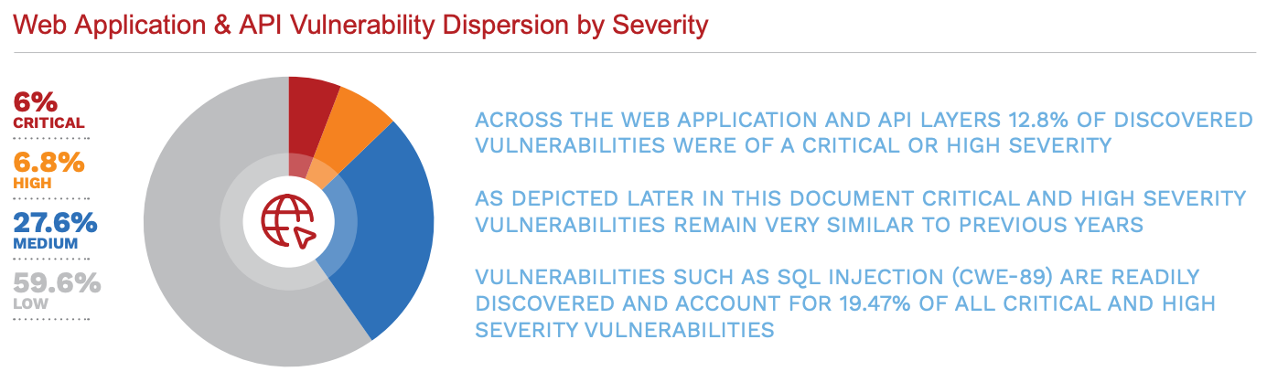
Source: Vulnerability Statistics Report in 2024 by Edgescan

Slide 8
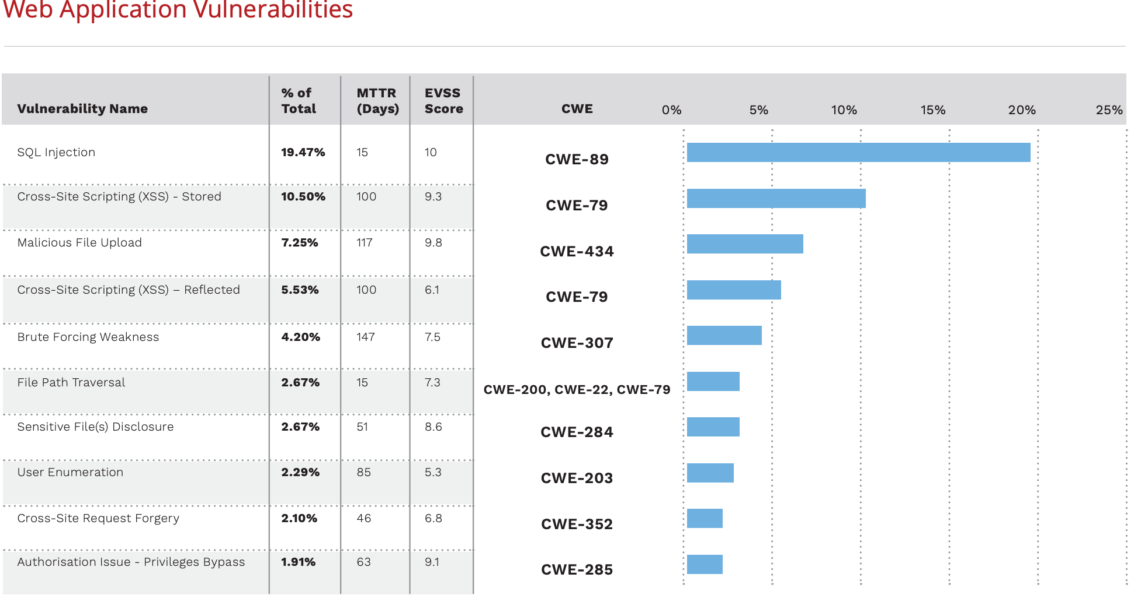
Source: Vulnerability Statistics Report in 2024 by Edgescan

Slide 9
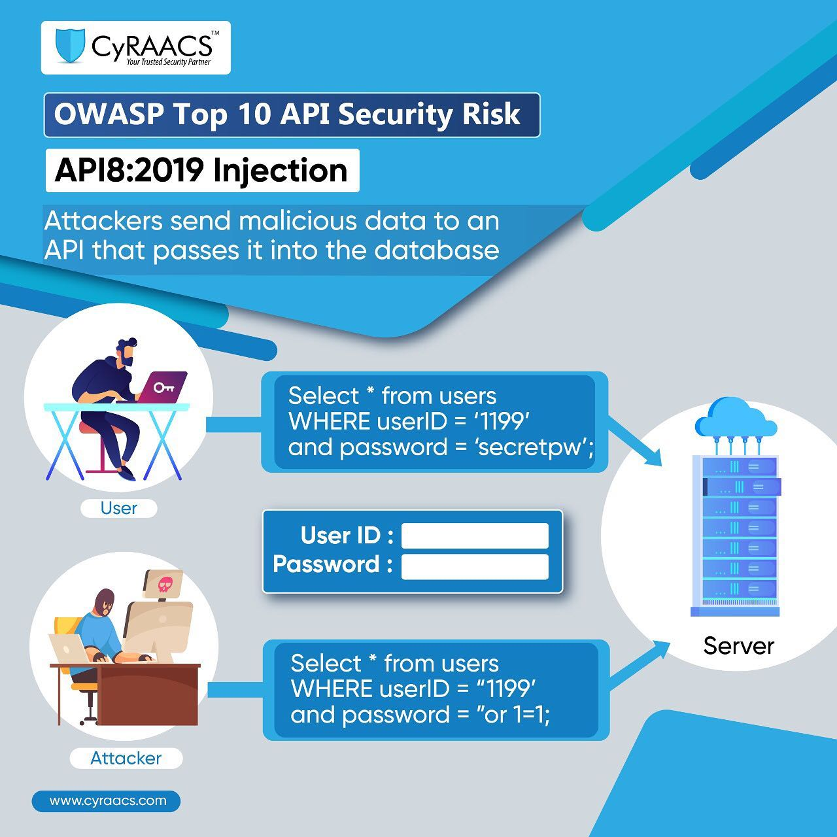

Slide 10
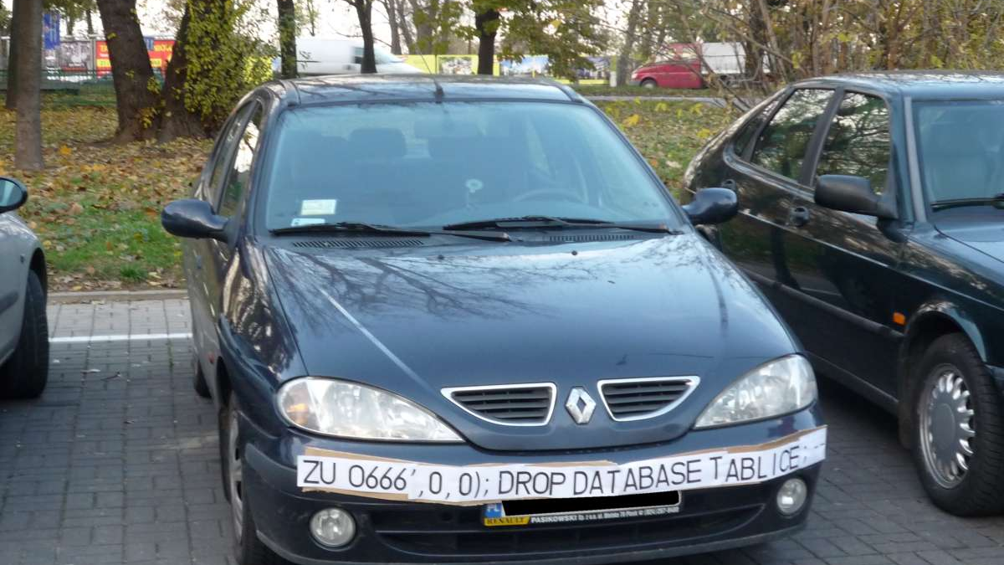

Slide 11
Secure Coding
Awareness Metrics Guidelines Controls
Bugs/defects and logic errors are typically the basis
Guard against accidental introduction of vulnerabilites
Embed in coding practices

Slide 12
Resources
ASVS – Application Security Verification Standard
SAMM - Software Assurance Maturity Model
OWASP
CWE - Common Weakness Enumeration (cwe.mitre.org)
CVE - Common Vulnerability and Exposure (cve.org)
Notes:
OWASP top 10 is not an actual standard!
Common Weakness Enumeration, Common Vulnerability Ex

Slide 13
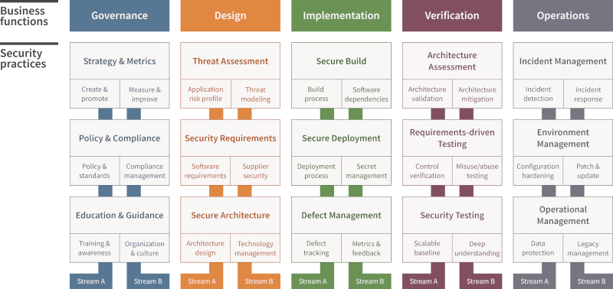

Slide 14
CVE
CWE
OWASP

Slide 15
An example
Log4J
CVE-2021-442288 https://nvd.nist.gov/vuln/detail/cve-2021-44228
Linked to CWE-20 (Improper Input Validation) (amongst others) https://cwe.mitre.org/data/definitions/20.html
Linked to OWASP A03:2021 – Injection https://owasp.org/Top10/A03_2021-Injection/

Slide 16
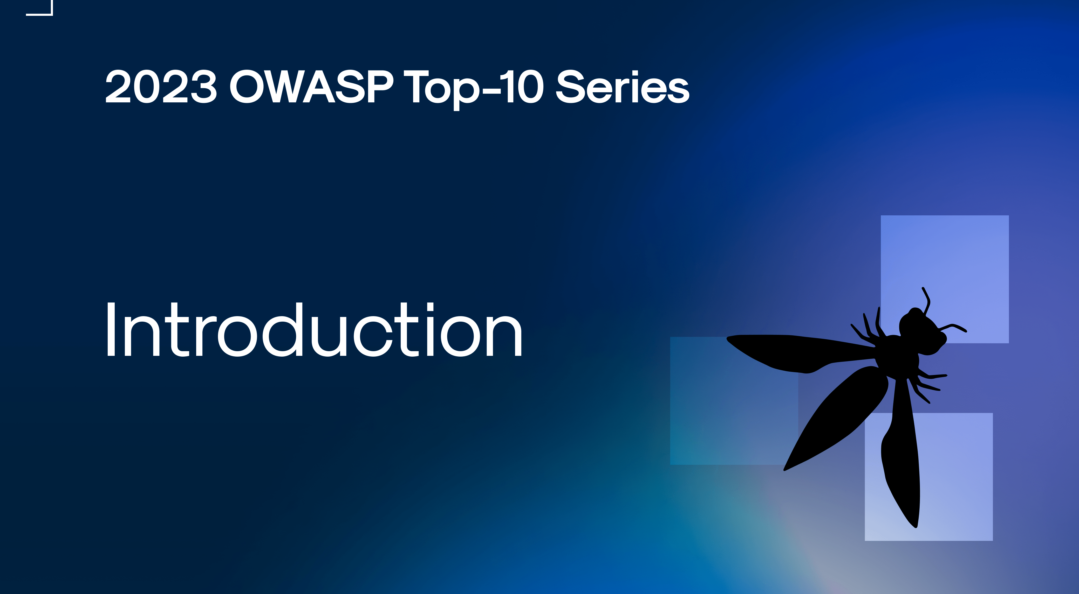

Slide 17

The Open Worldwide Application Security Project
Open-source software projects
Over 250+ local chapters worldwide
Tens of thousands of members

Slide 18
… to make software security visible, so that developers everywhere could make truly informed decisions about the risks and solutions.

Slide 19
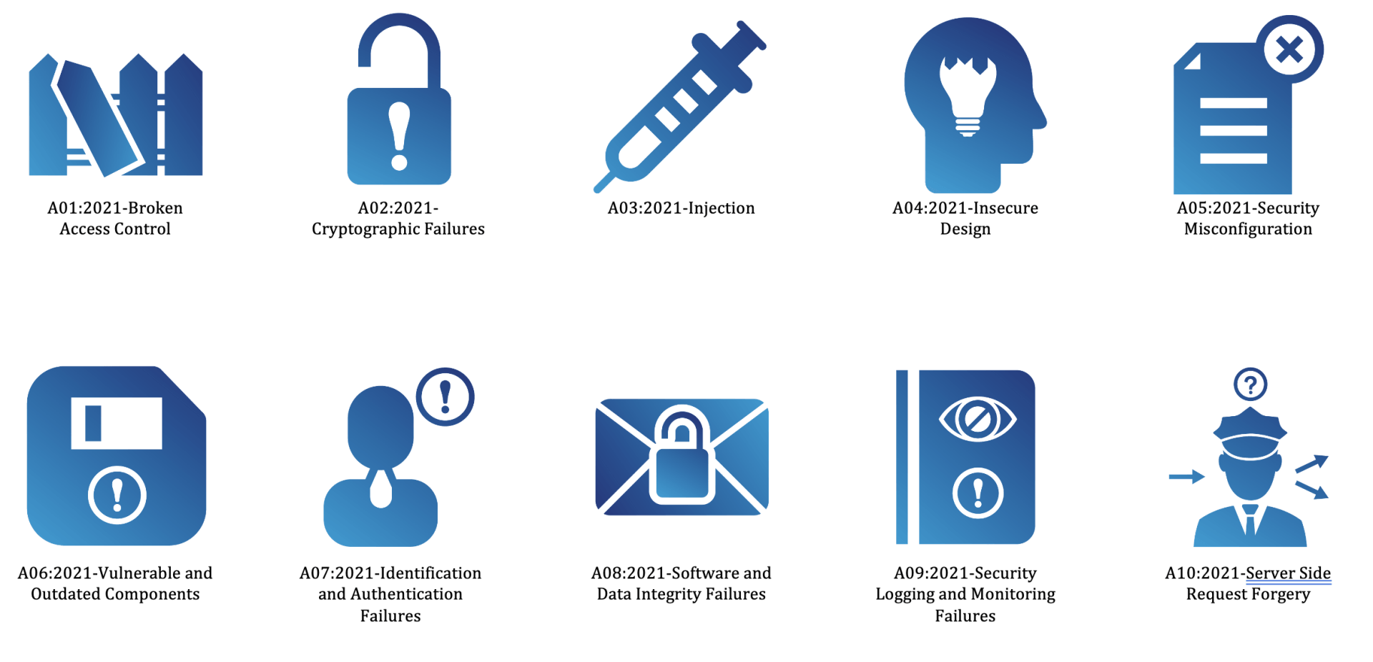
OWASP Top 10 Introduction

Slide 20
OWASP Top 10 Ordering
Incident Rate
Exploitability
Impact

Slide 21
OWASP Data Factors
CWEs mapped
Max Incidence Rate
Avg Incidence Rate
Avg Weighted Exploit
Avg Weighted Impact
Max Coverage
Avg Coverage
Total occurrences

Slide 22
A01 Broken Access Control
Bypass access control checks
Unauthorized access to accounts
Unauthorized creation, reading, updating and deletion of data
Elevation of privilege
Typically ignoring the principle of least privilege: denying access by default.
https://owasp.org/Top10/A01_2021-Broken_Access_Control/
Notes:
Privacy and regulatory impacts
The biggest breaches and largest costs
Counter: proper e2e testing practice + automation, awareness!

Slide 23
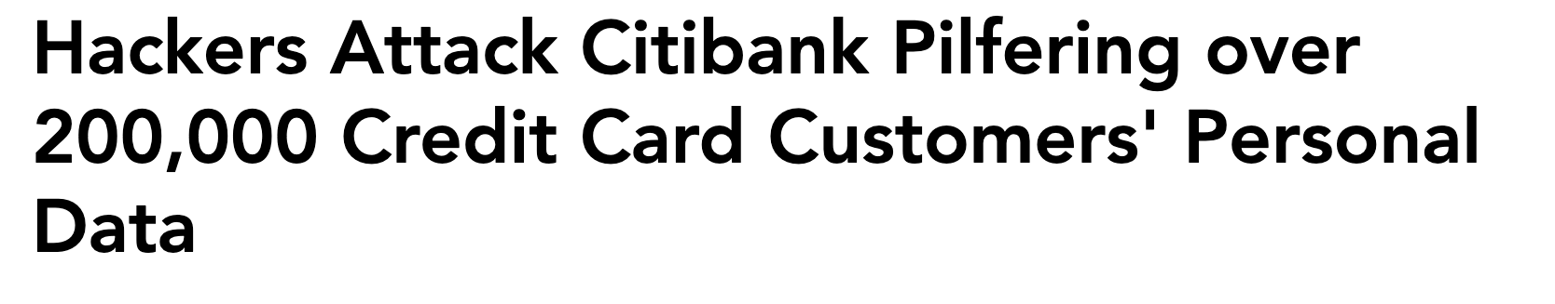
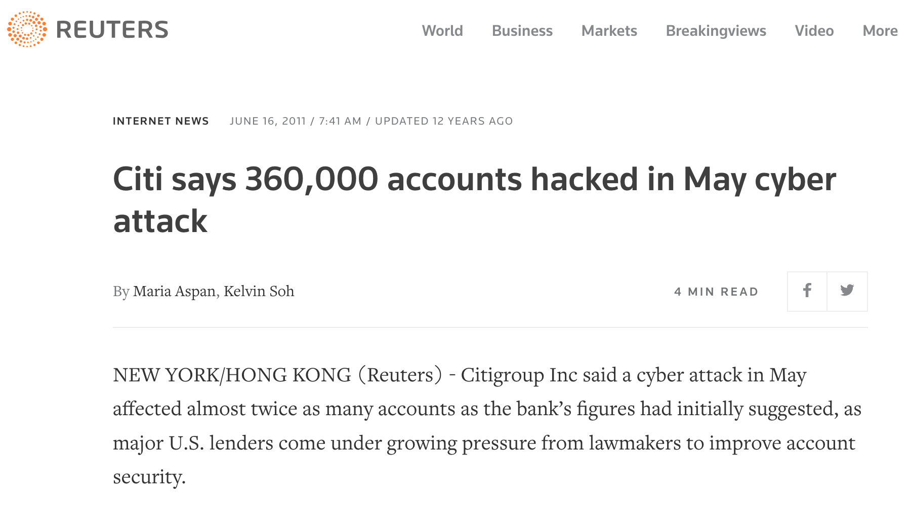
A01 Example
Citibank confirms hacking attack - BBC News

Slide 24
OWASP for APIs

Slide 25
OWASP Top 10 API Security Risks – 2023
Broken object level authorization
Broken authentication
Broken Property level authorization
Unrestricted resource consumption
Broken Function level authorization
Unrestricted Access to Sensitive Business Flows
Access Control!

Slide 26
OWASP Top 10 API Security Risks – 2023
7. Server-Side Request Forgery
8. Security Misconfiguration
9. Improper Inventory Management
10. Unsafe Consumption of APIs

Slide 27

Demo: Investigating an insecure API

Slide 28
Hardening

Slide 29
Hardening
Hardening your APIs and Web Applications works on different levels:
- Secure design
- Code, design - writing - reviewing
- Configuration
- Package and dependency management
- Our CI/CD pipeline, QA and Security control

Slide 30
Some common issues
Cross-site scripting
Cross-site request forgery
(unsufficient or missing) Validation
Exposing sensitive application logging
Missing access control

Slide 31
Secure Code Review Checklist
Sanitize and validate all input
Never store secrets as code/config
Test for new security vulnerabilities introduced by third-party open source dependencies
Enforce secure authentication
Enforce the least privilege principle
Handle sensitive data with care
Protect against well-known attacks
Statically test your source code, automatically

Slide 32
Use Github Advanced Security Scanning
Integrate with DevOps pipelines
Dependency scanning
Secrets scanning
Code scanning
Extend by writing custom scans with CodeQL

Slide 33
Summary

Slide 34
Questions ?

Slide 35

Thank you!

